Slide 1
CSD 3102 ARTIFICIAL INTELLIGENCE TECHNIQUES MODULE IV
PLANNING
Topic:Planning Graph

Slide 2
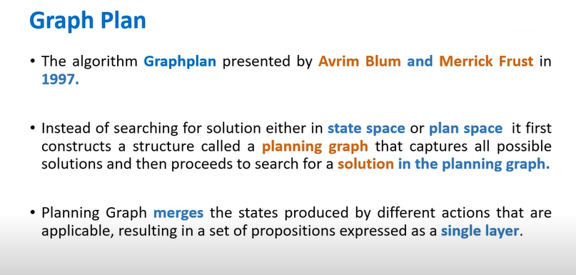
PLANNING GRAPH
A planning graph is a data structure used in artificial intelligence (AI), particularly in automated planning and problem-solving. It provides a compact representation of the state space in a planning problem, helping to analyze the relationships between actions and propositions over time.

Slide 3
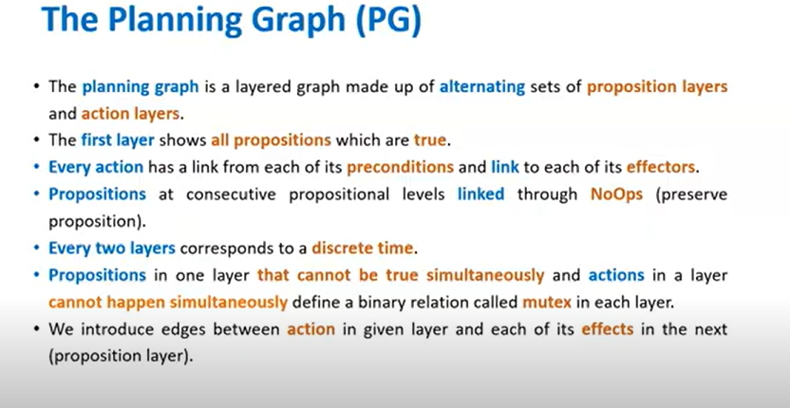

Slide 4
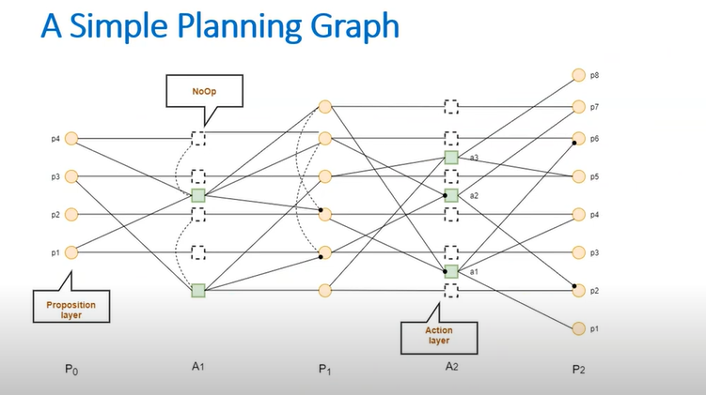

Slide 5
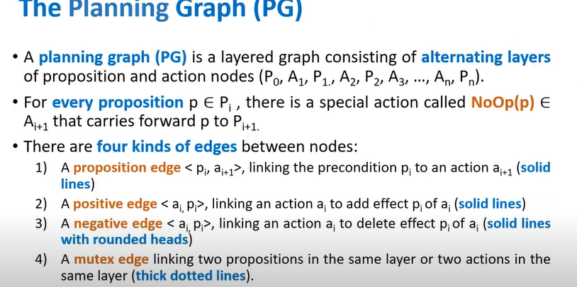

Slide 6
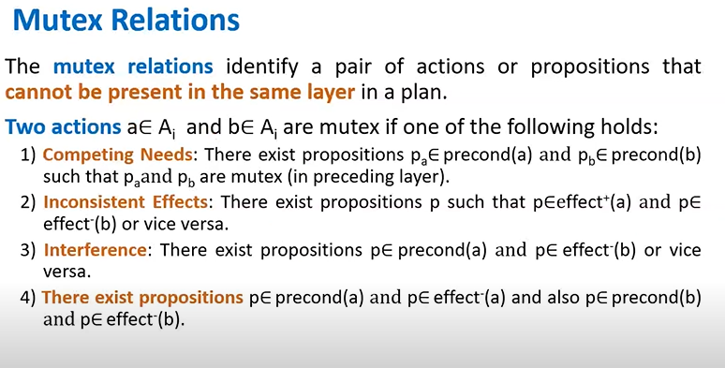

Slide 7
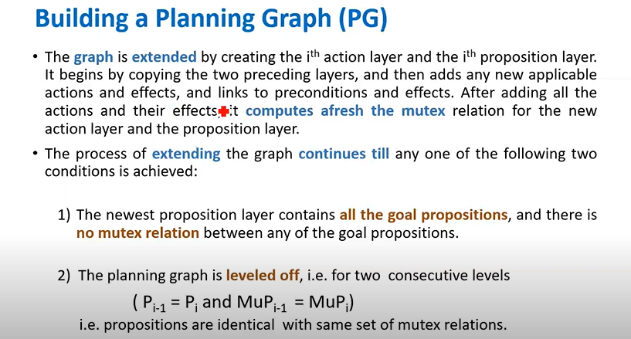

Slide 8
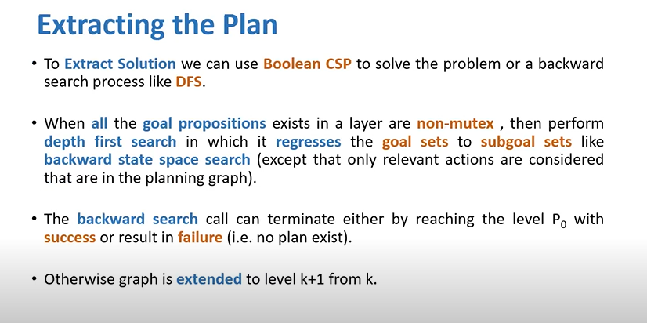

Slide 9
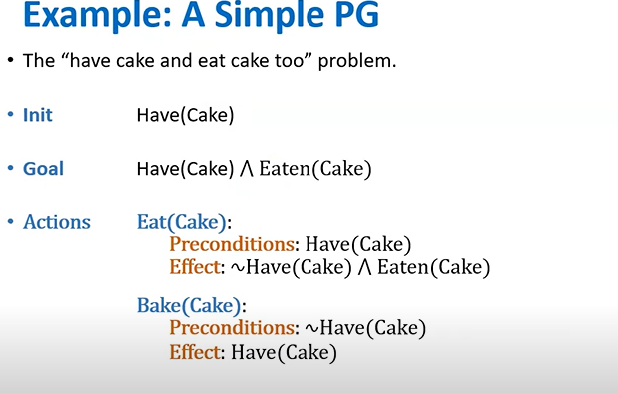

Slide 10
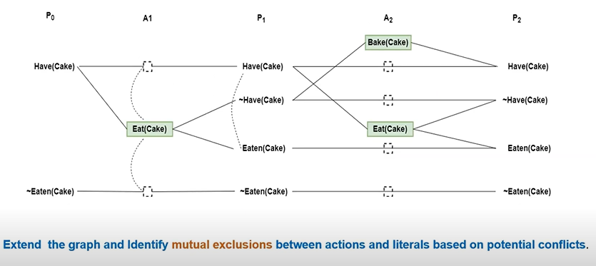

Slide 11
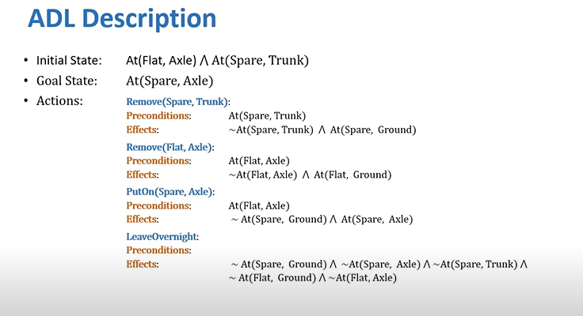
SPARE TIRE PROBLEM

Slide 12
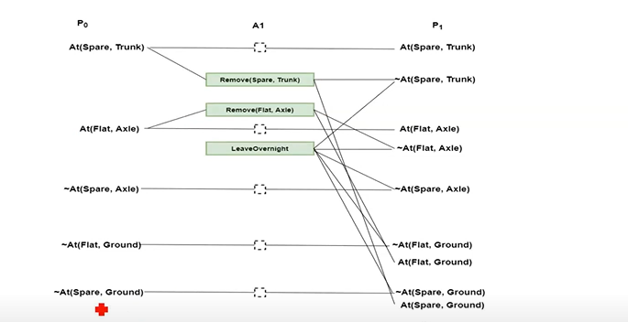

Slide 13
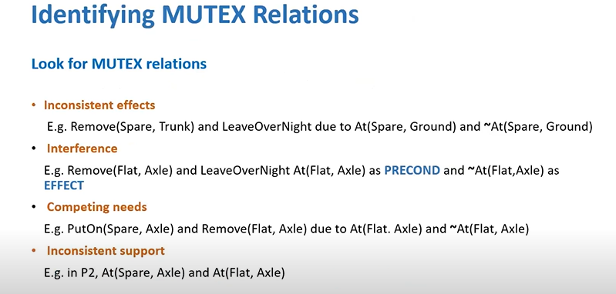

Slide 14
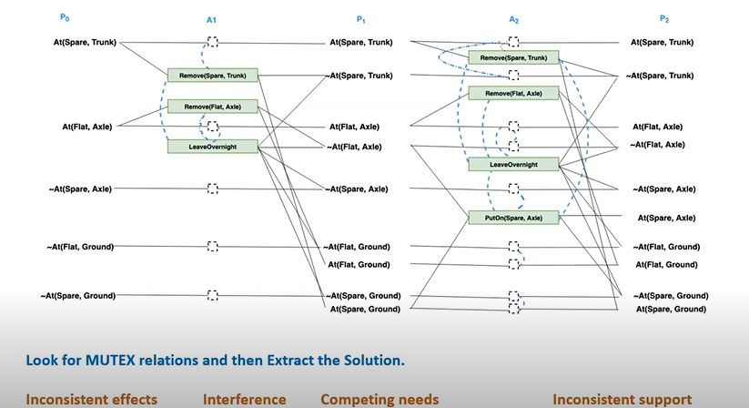

Slide 15
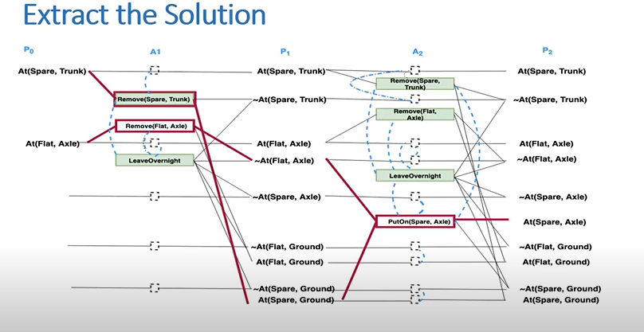

Slide 16
